Slide 1
User guide for doorboard prototype
All professors’ information in this prototype are from http://www.cs.umd.edu/people/faculty
All icons were from http://fontawesome.io/

Slide 2
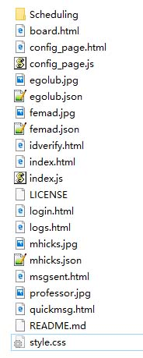
Getting started
Main interface for doorboard
After downloading the package, you will be able to see these files.
Main interface for client, which owner of the doorboard can use to configure his board and receive notification and messages.

Slide 3
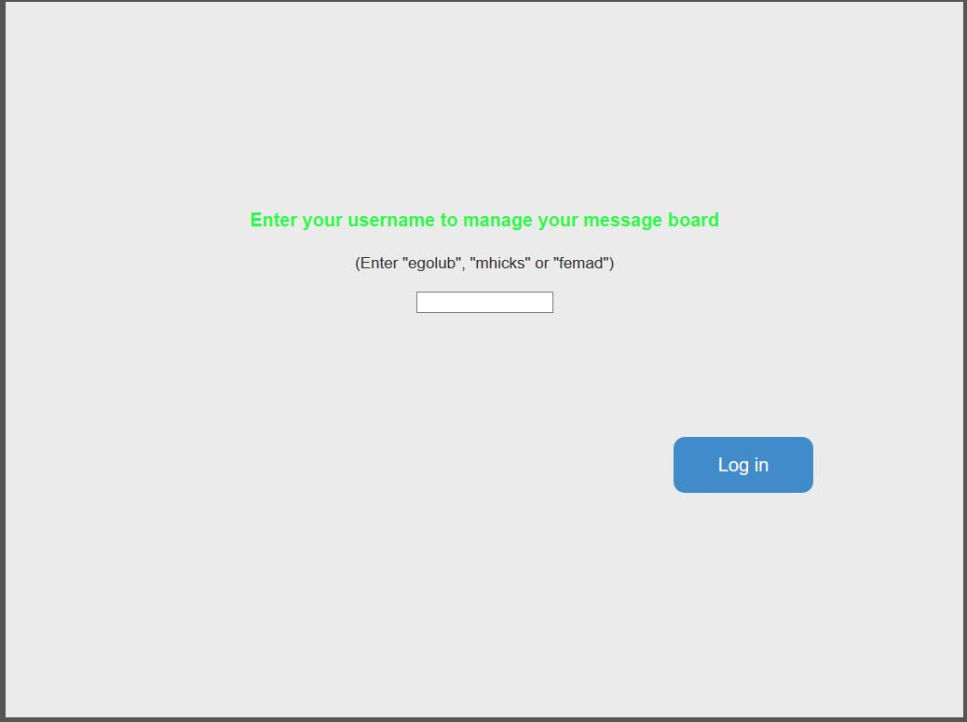
Open login.html with browser(Firefox in this guide) you will be able to see a login page.

Slide 4
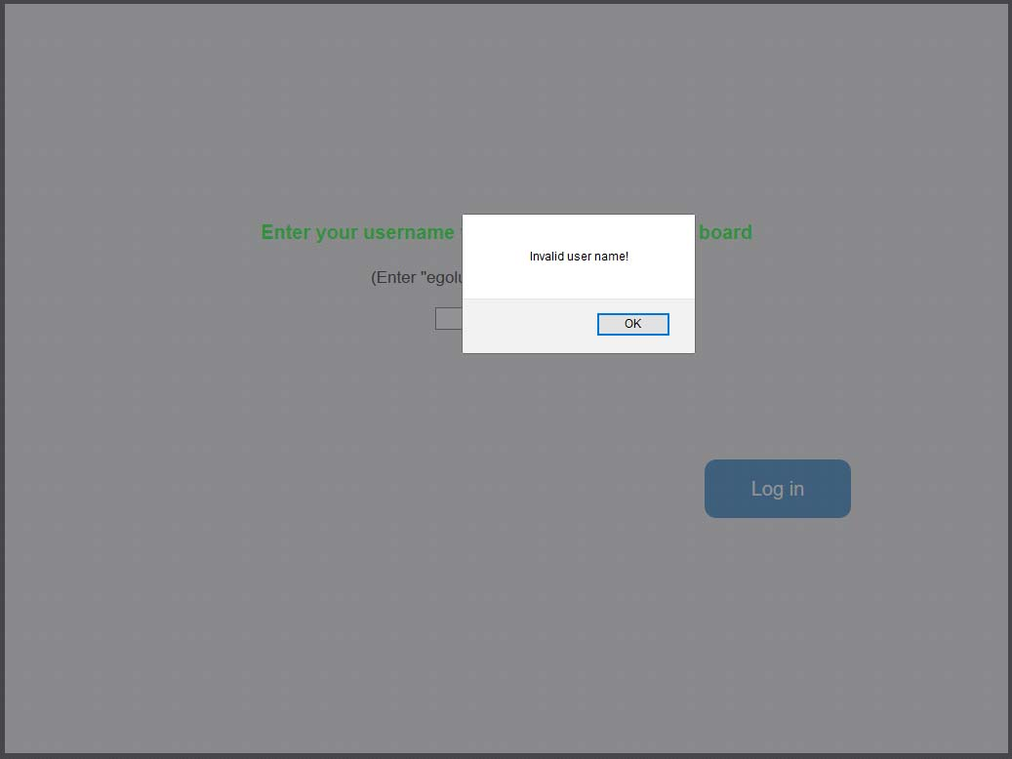
If any empty name is entered, an “invalid user name” alert will be shown.

Slide 5
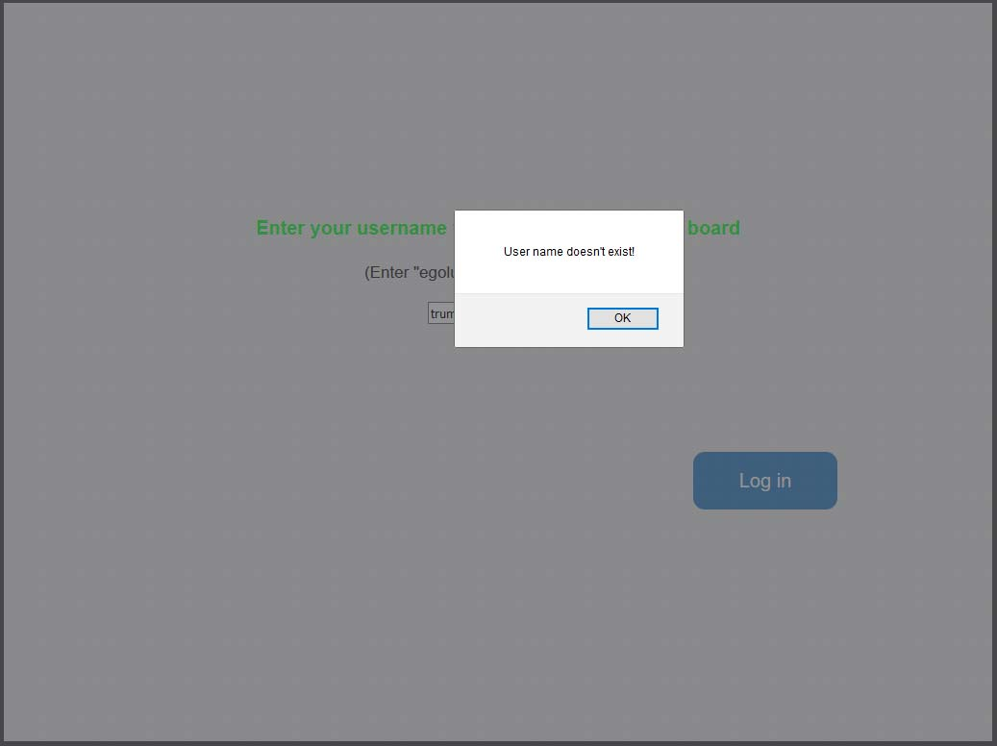
If an username that is not in the database is entered, a “doesn’t exist” alert will be shown. At current stage, there are 3 users in the database: “egolub”, “mhicks” and “femad”.

Slide 6
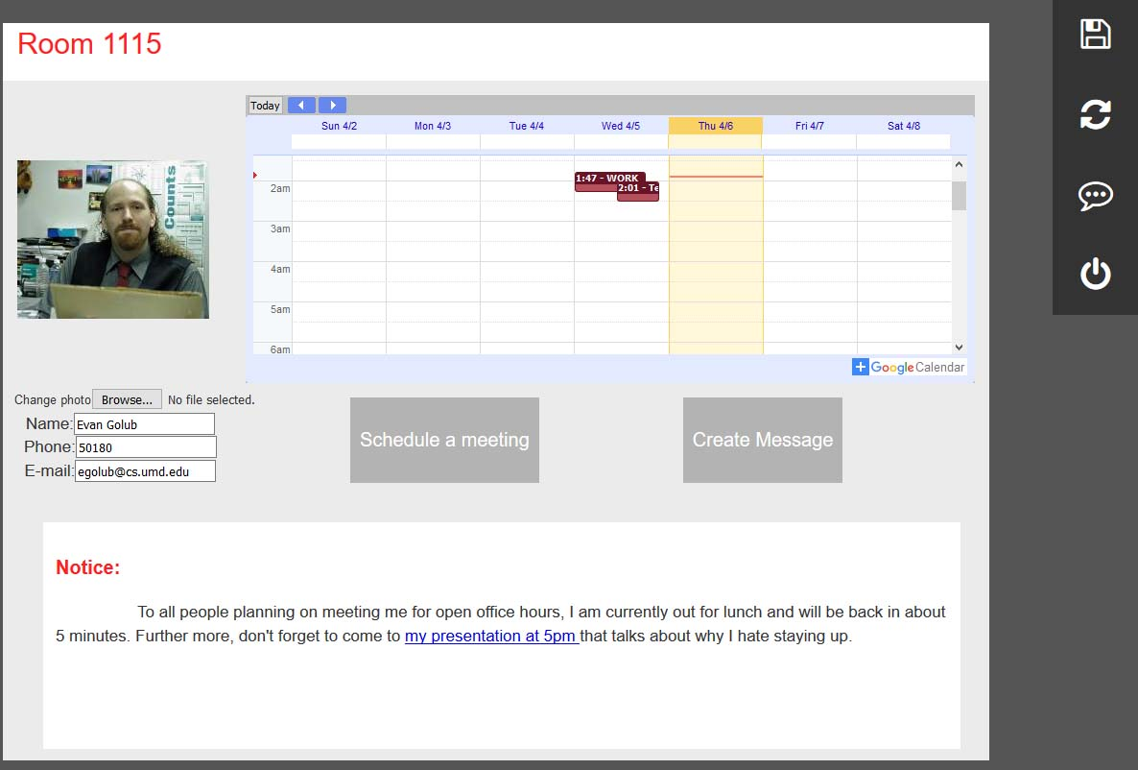
Login as “egolub”, you will be able to see the configuration page where you can change your information and check notification/messages from your doorboard.

Slide 7
A tool bar with four buttons will show up on the top right corner.

Slide 8
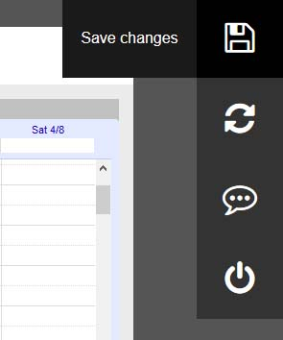
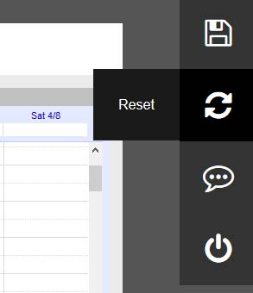
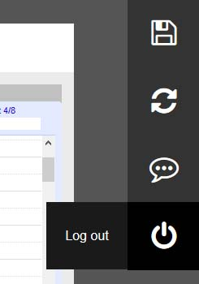
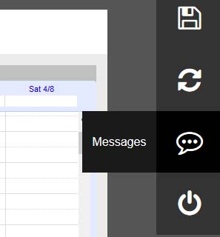
You can mouse over them to see the tool tip.

Slide 9
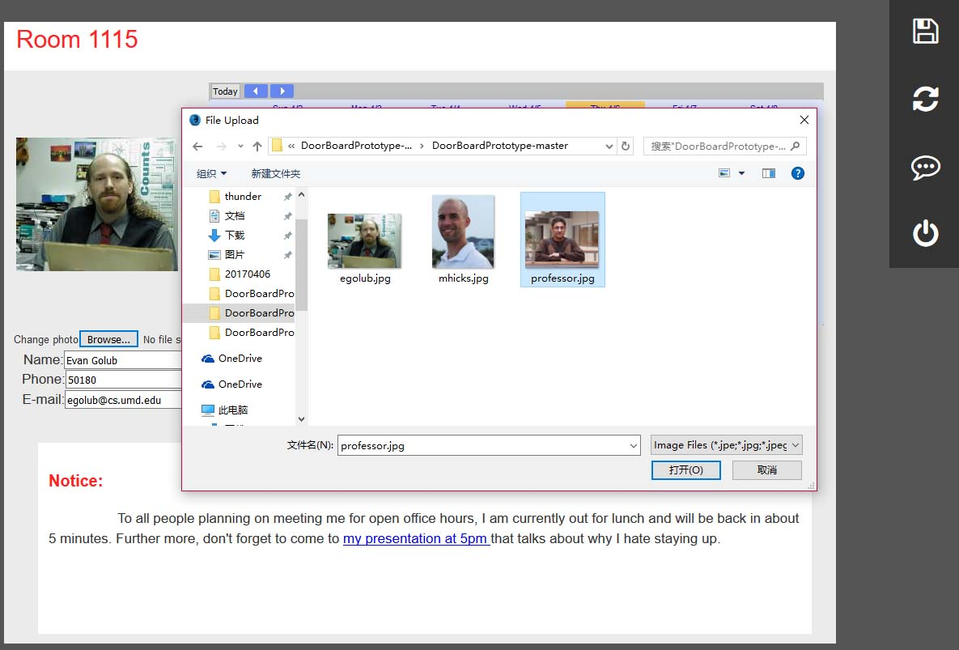
By clicking on the browse button, you can change the profile photo.(The photo has to be at the same directory as these html files)

Slide 10
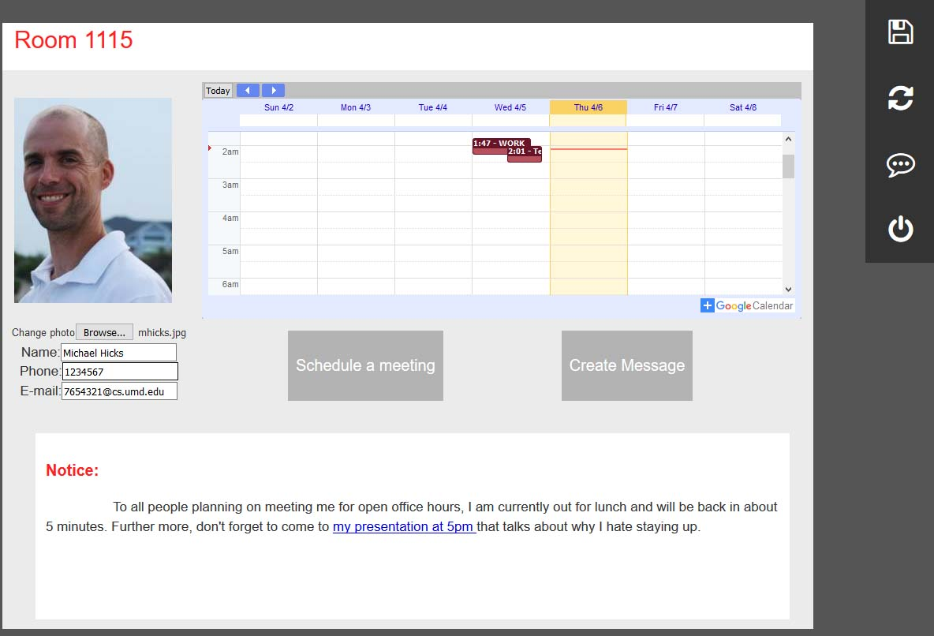
After selecting the photo, you can see the preview.
You can also change any information in these text box.

Slide 11
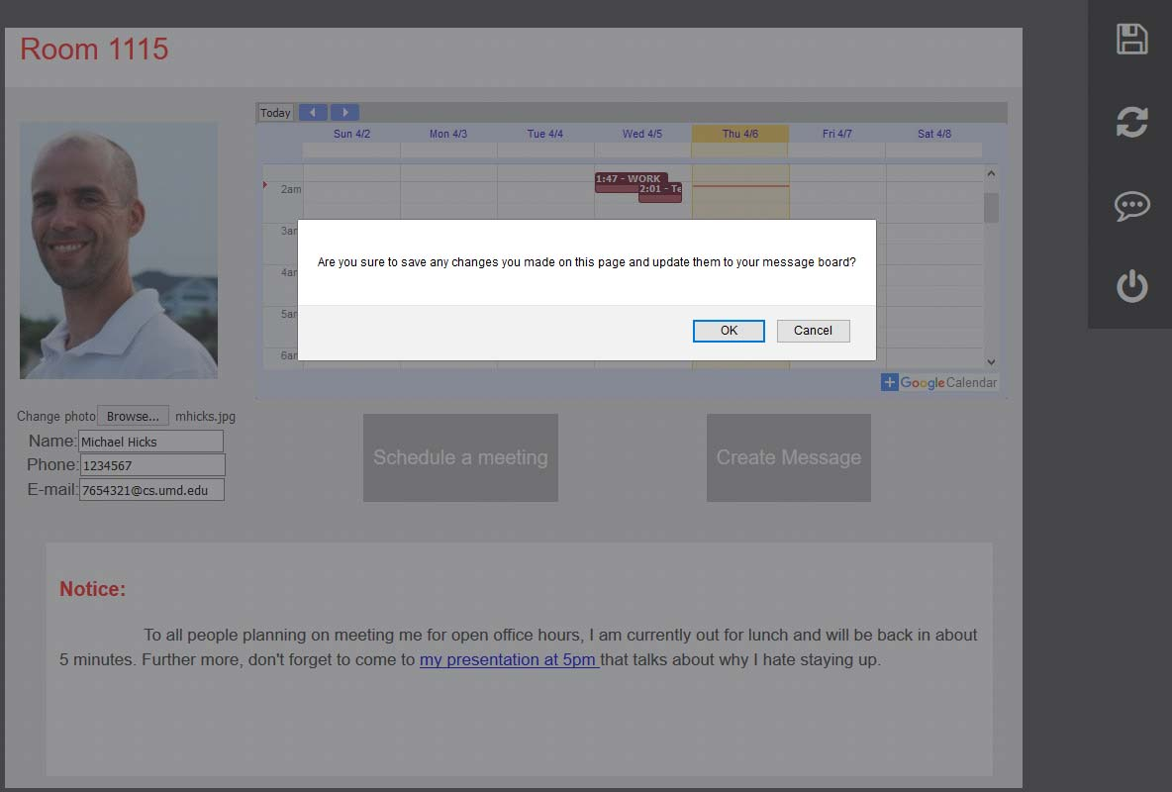
All changes will not be saved until you click the save button.

Slide 12
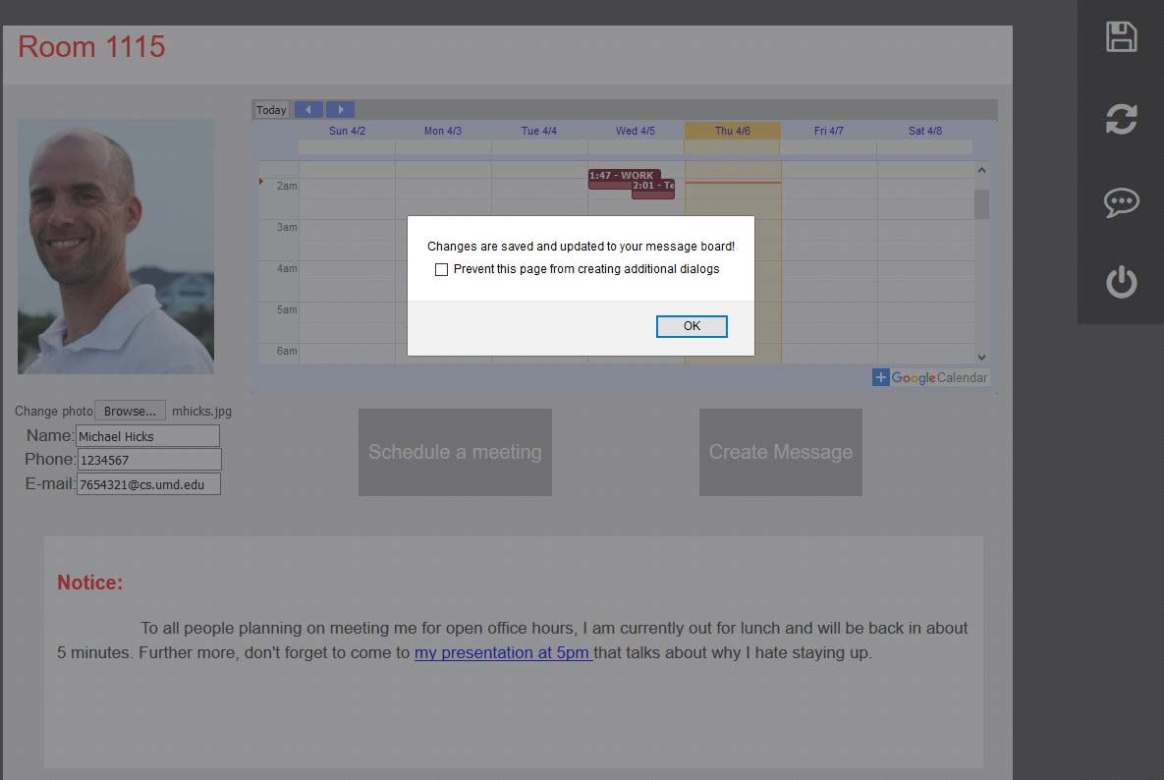
After confirmation, all changes will be saved and shown on doorboard.

Slide 13
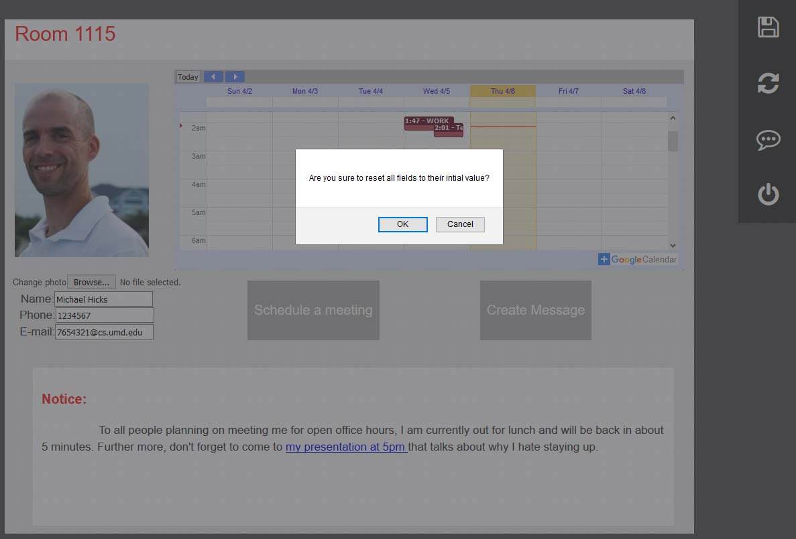
You can use the reset button if you want to reverse any changes you saved.

Slide 14
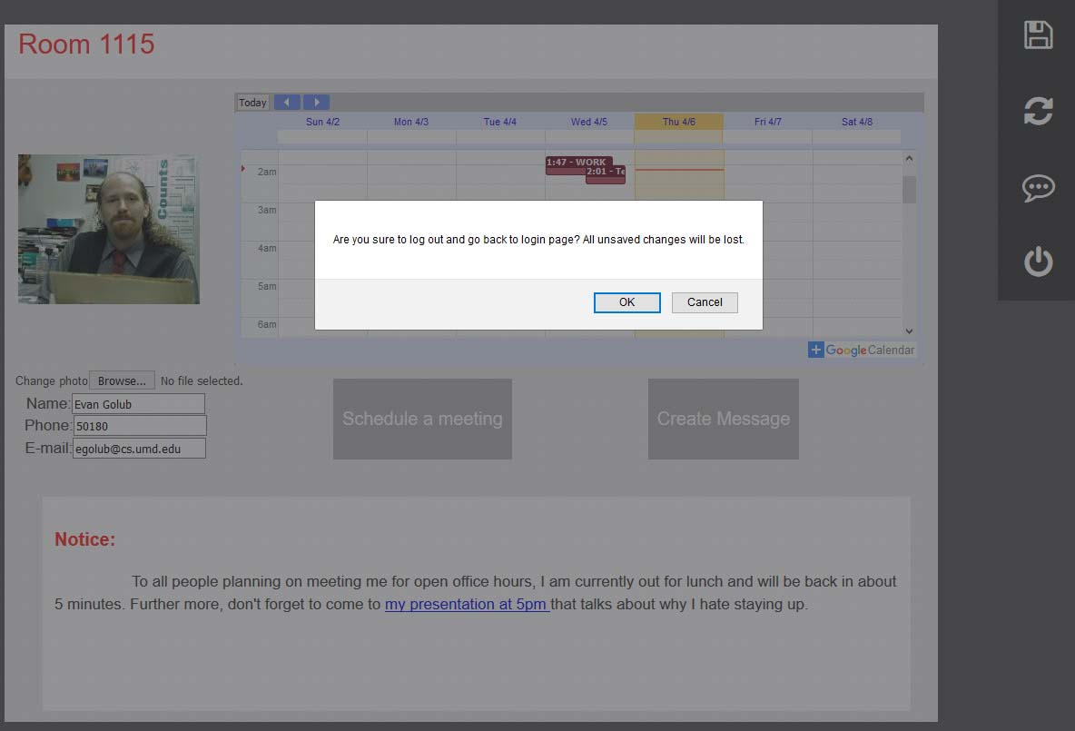
By clicking the log out button, you can go back to the login page.

Slide 15
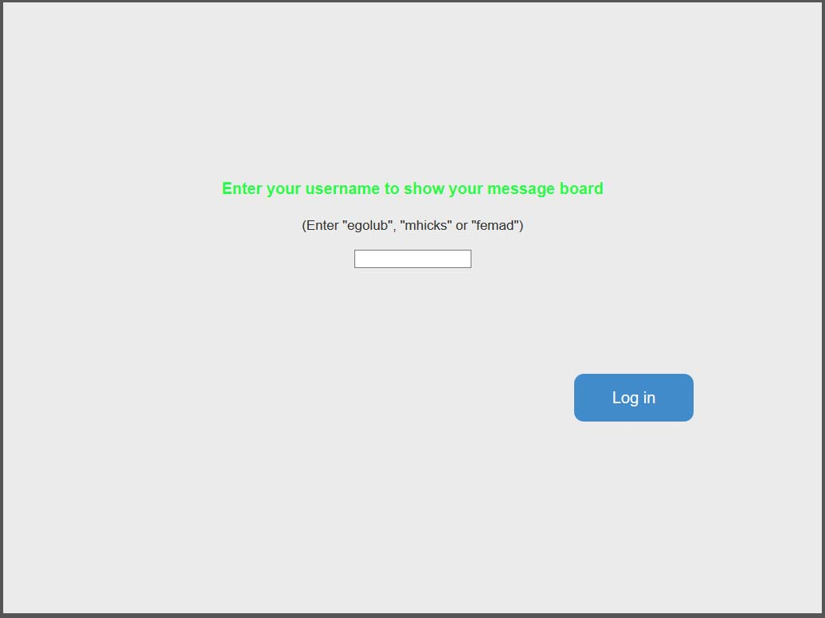
Log in board.html with one of these three usernames will show corresponding display on the doorboard.

Slide 16
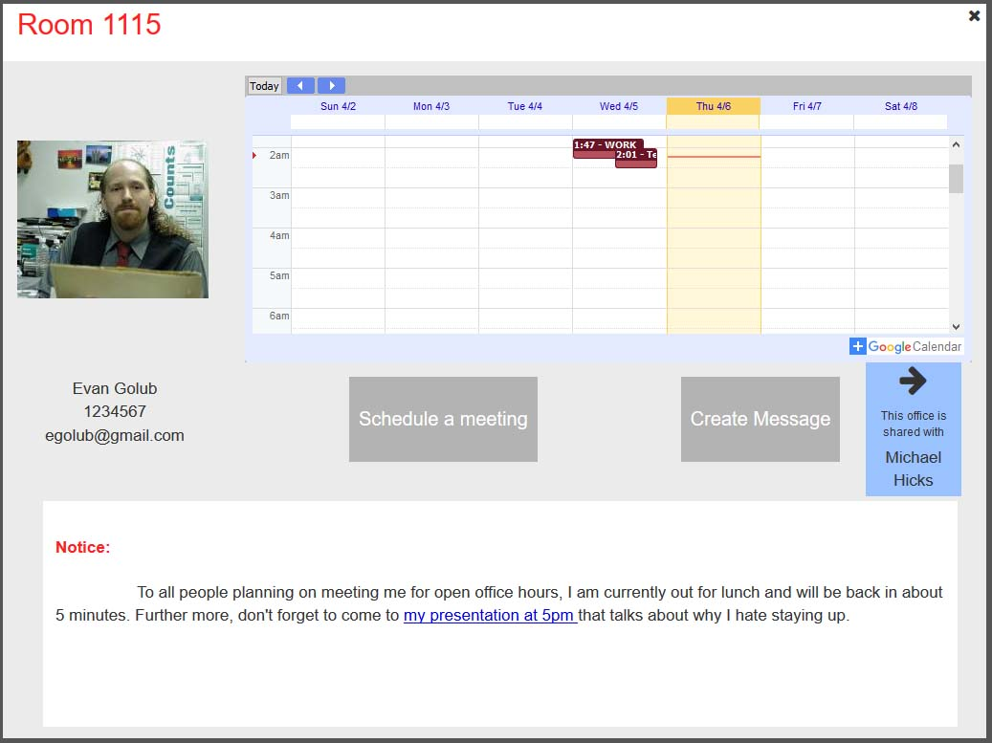
This is what the page looks like on the doorboard.
If two faculties share the same office, a switch button will appears on the right. Cliking it will switch the board to show other faculty’s page.

Slide 17
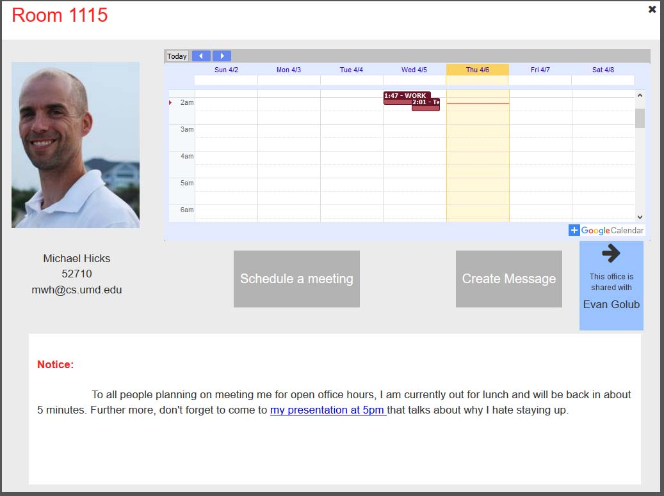
You will go back to the login page if you click on the cross button.

Slide 18
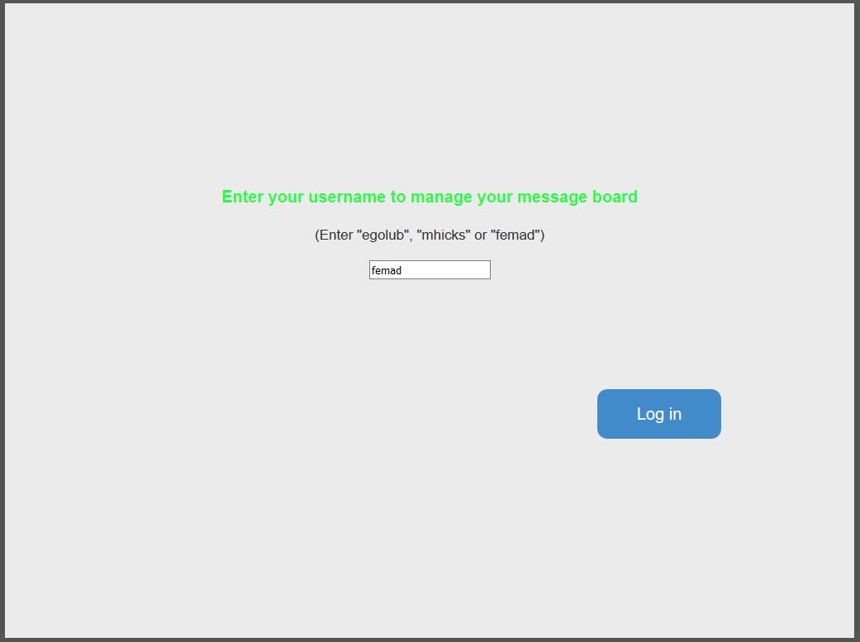
By using another username, you can see what other pages look like on other doorboard.

Slide 19
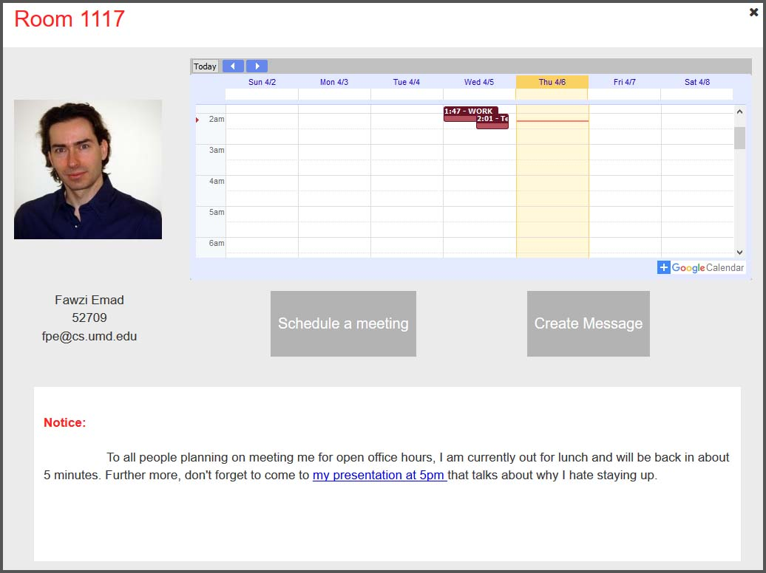
If there’s only one person owns the office, such button will not be shown.

Slide 20
The “create message” button enables visitors to send a quick message to the owner of the doorboard.

Slide 21
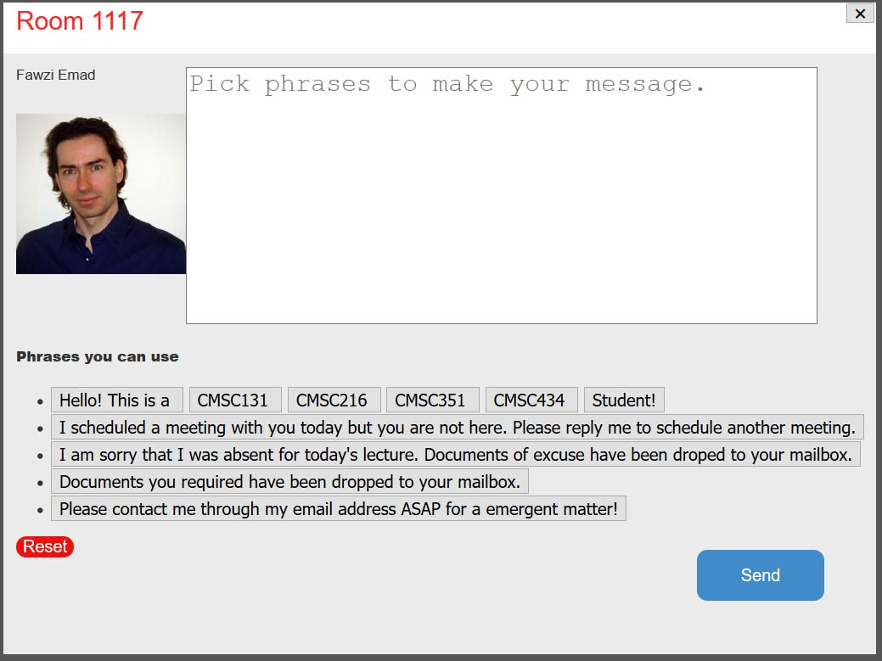
Click on button, the interface where you can create the message by either picking phases or typing directly on the text area will show up.

Slide 22
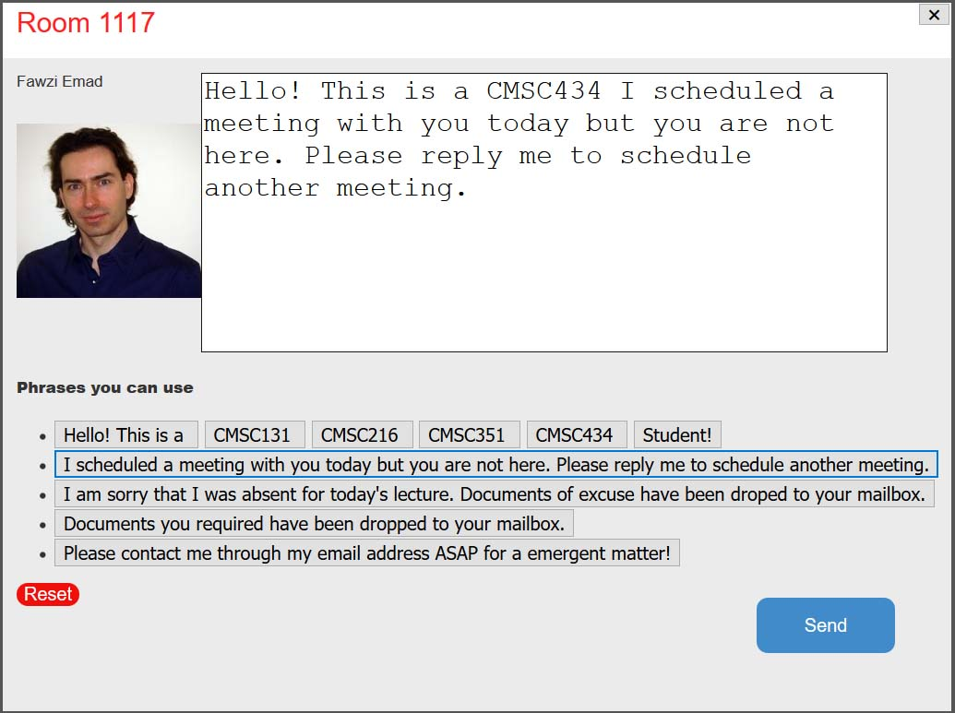
You can go back by click the cross on top right of the screen.
If you finish the message, you can send it by clicking the send button.
Click on the reset button will clear everything in the text area above.

Slide 23
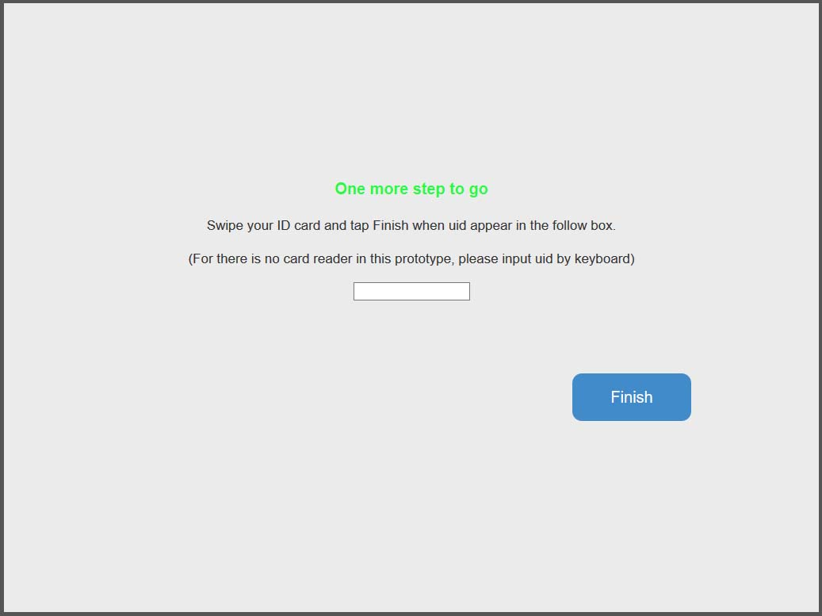
If you click the send button, you will need to swipe your id to finish the process.

Slide 24
